Slide 1
JobLog Funtion Start
유기종 대리
2019.11.29

Slide 2
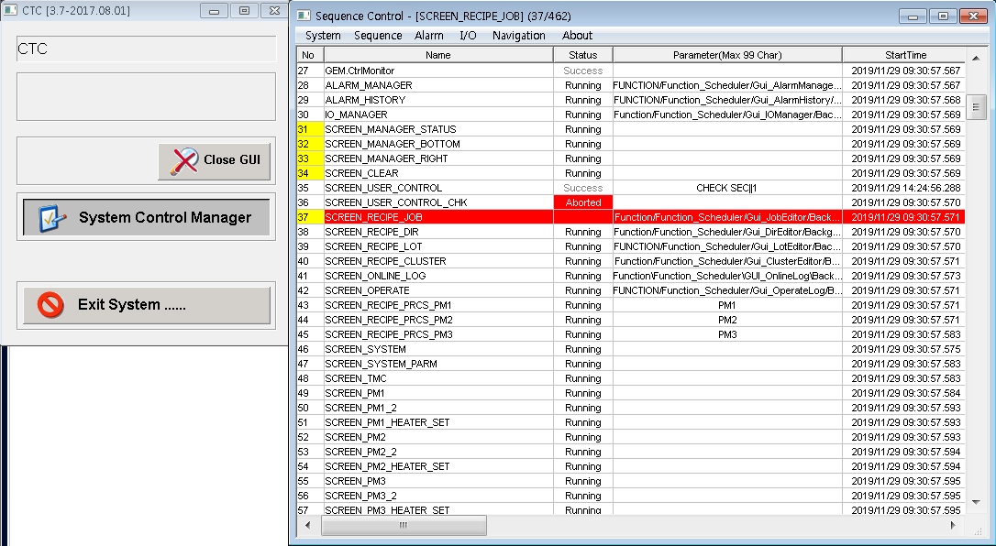
JobLog Funtion Start
- System Control Manager 클릭
- Sequence Control 윈도우 창에서 ‘SCREEN_RECIPE_JOB’ 더블 클릭
WONIK Confidential

Slide 3
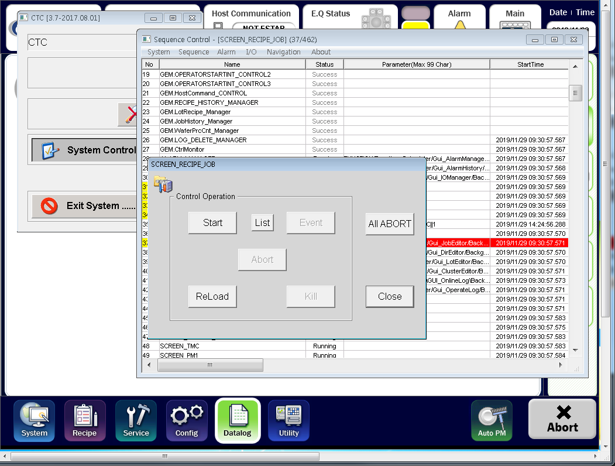
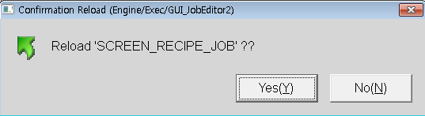
JobLog Funtion Start
- ReLoad 선택 후 Yes 선택
WONIK Confidential

Slide 4
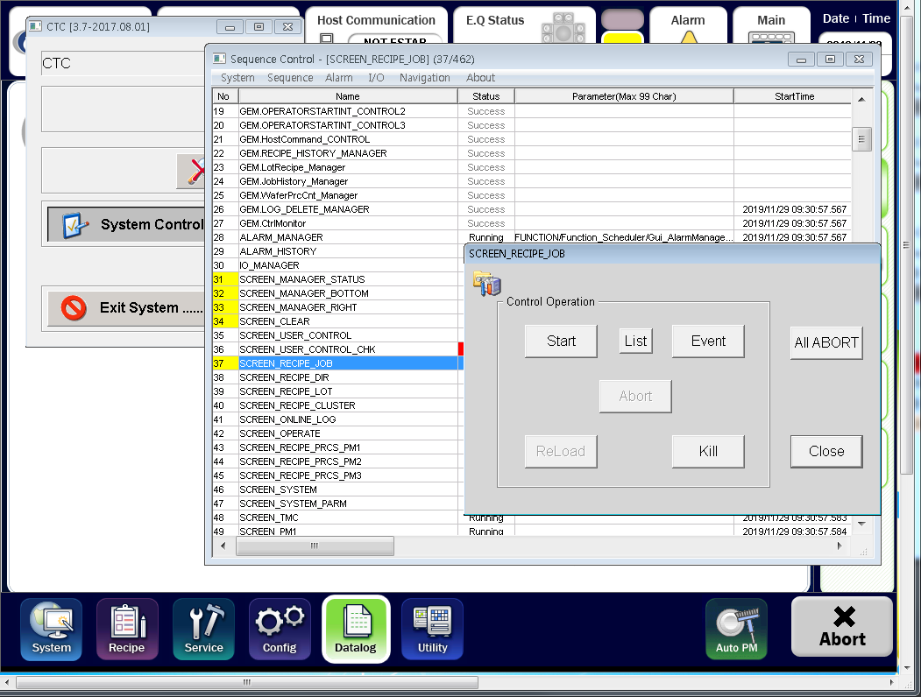
JobLog Funtion Start
- ReLoad 선택 후 Yes 선택
WONIK Confidential

Slide 5
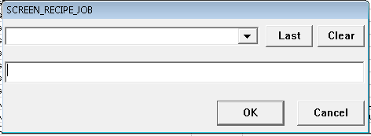
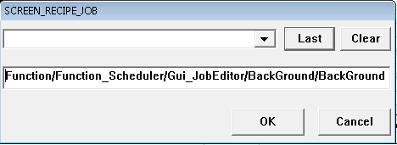
JobLog Funtion Start
- ‘Last’클릭 후 ‘OK’ 클릭
WONIK Confidential

Slide 6
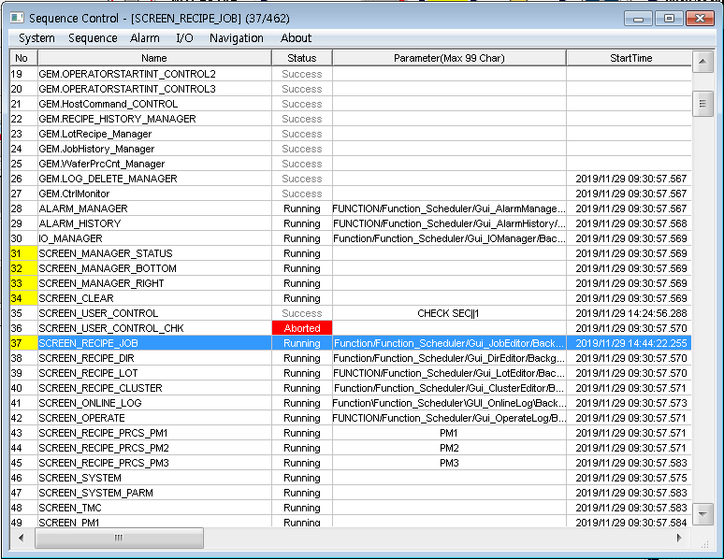
JobLog Funtion Start
- Status Runring 상태 확인 후 완료&Test
WONIK Confidential

